Slide 1
Maze Generation and Solving
Sam Baumann
Apr 5, 2023

Slide 2

About me
MS Candidate in Computer Science
BS in Computer Science Spring ‘22
Advisor: Dr. Plank
Employment: American Accessories Int’l
Notes:
First and last year master’s student (5 year program)
Graduated from UT Last Spring
Dr. Plank is my advisor – don’t do research work
Do software engineering for American Accessories Int’l

Slide 3
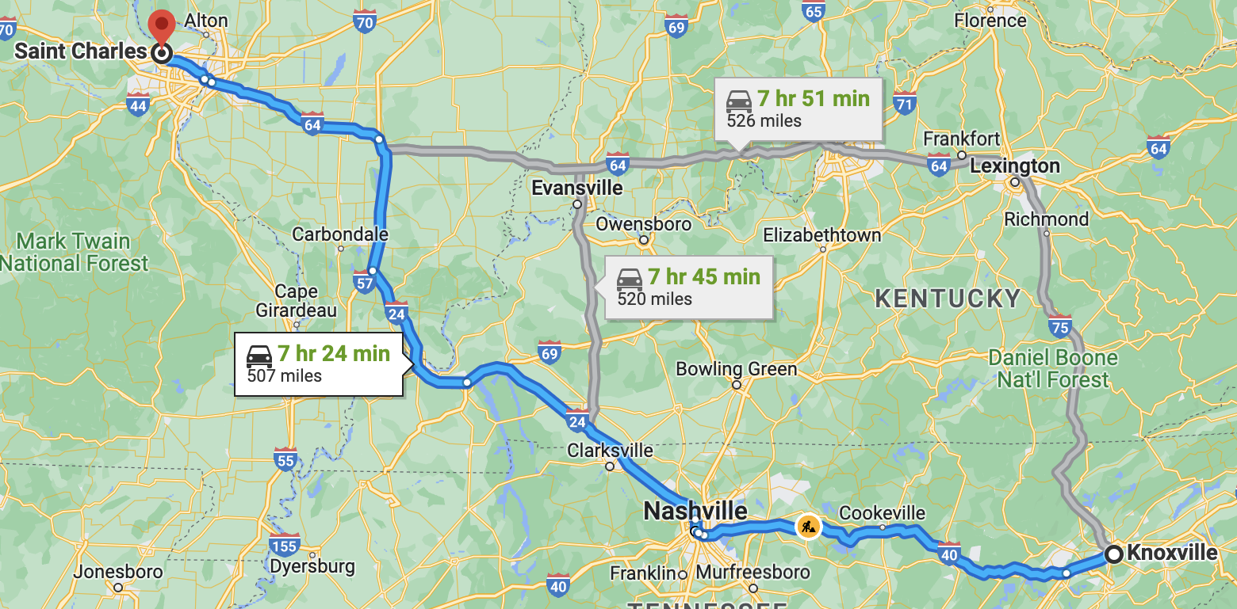
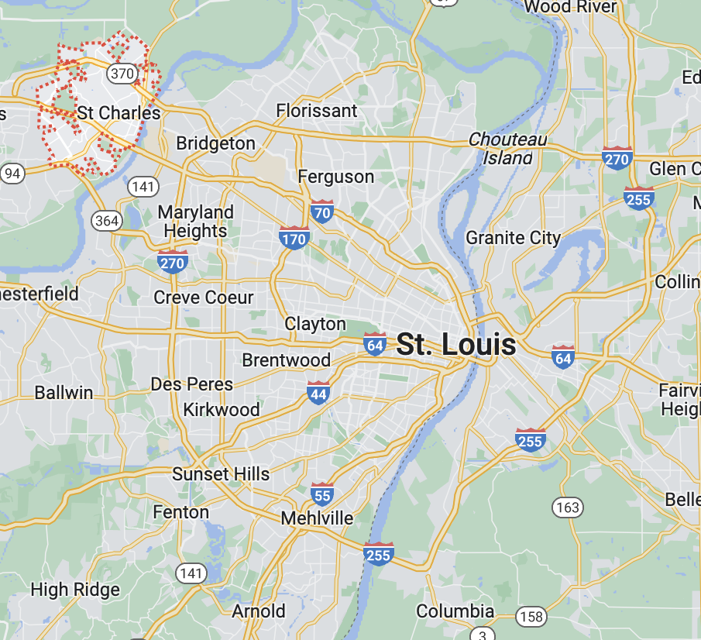
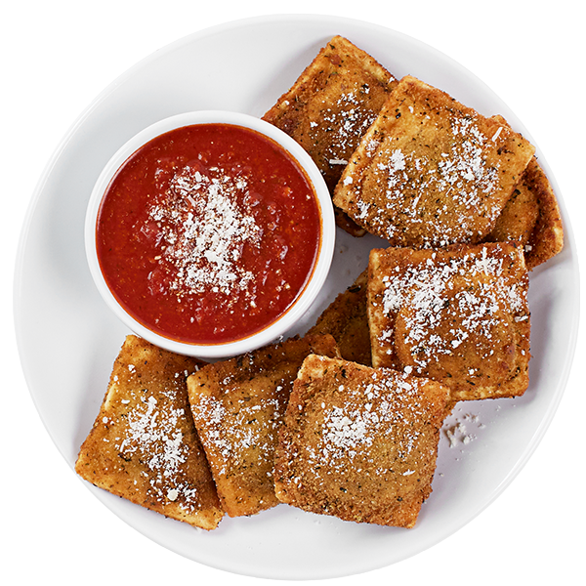
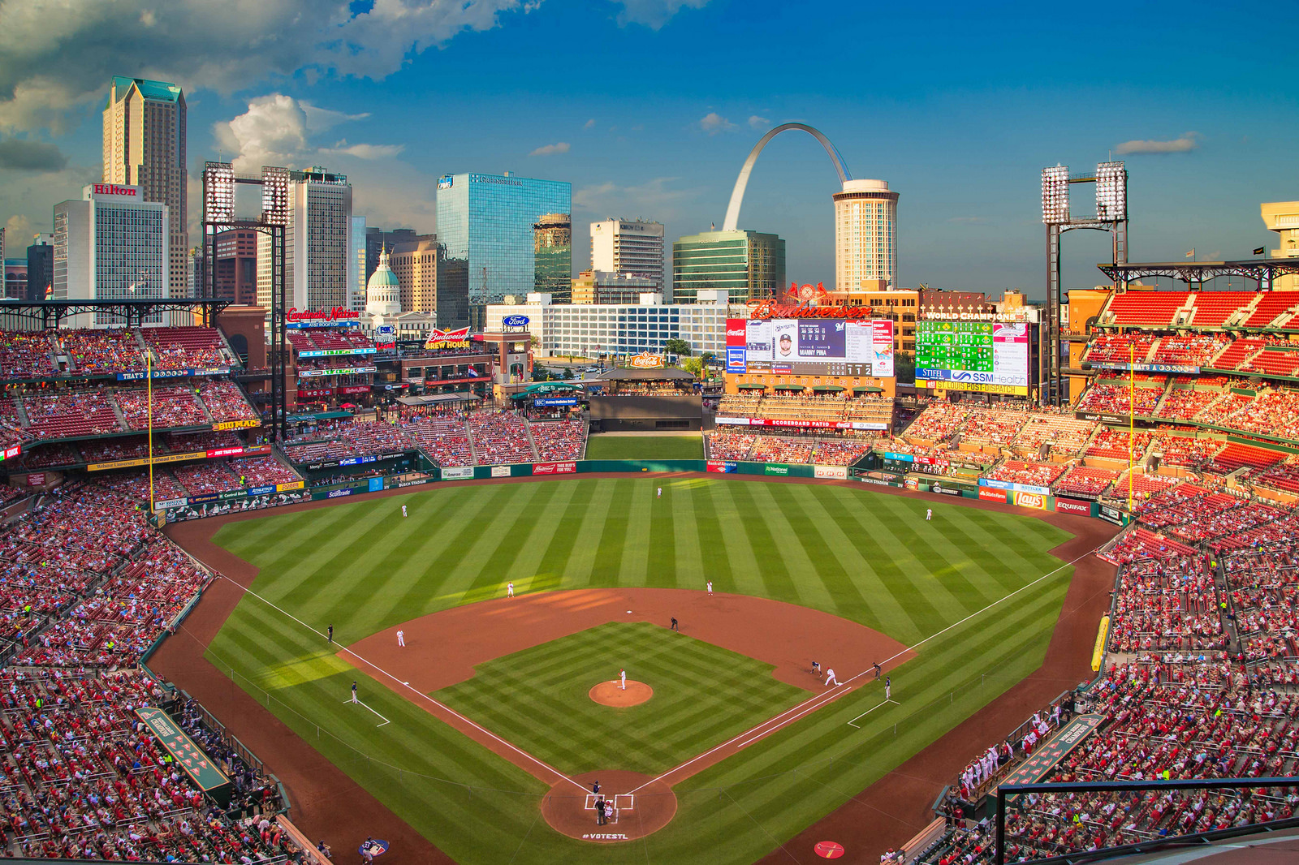
About Me
Hometown: St. Charles, MO
Notes:
Toasted Ravs - St. Louis Delicacy

Slide 4
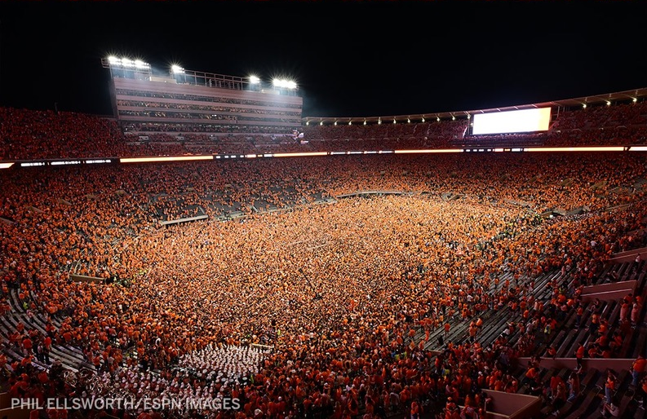


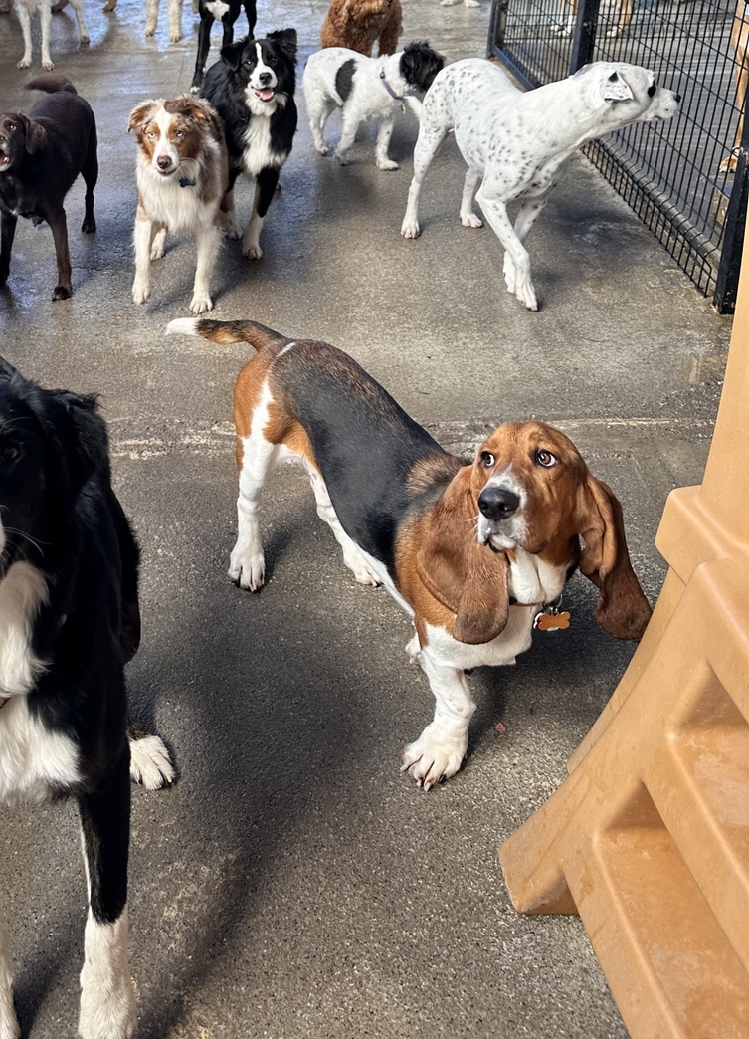
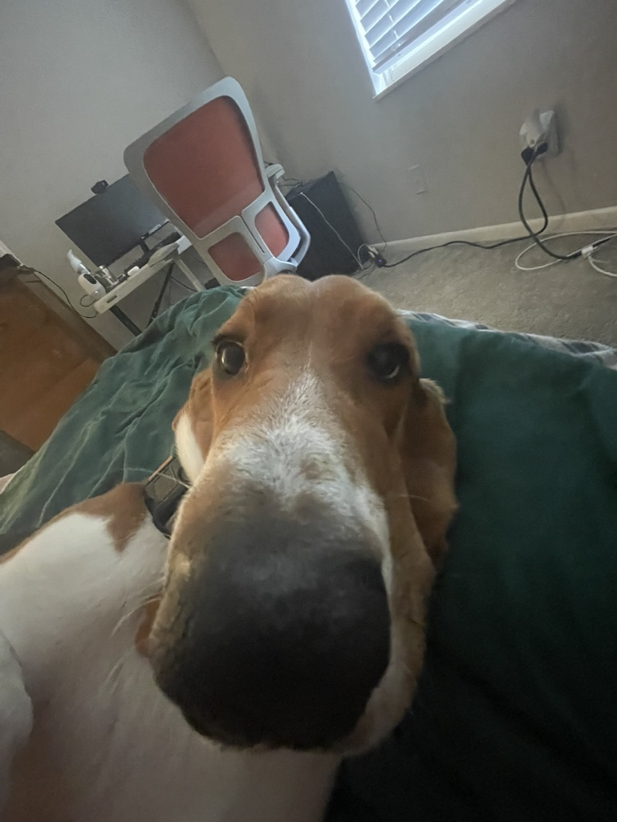
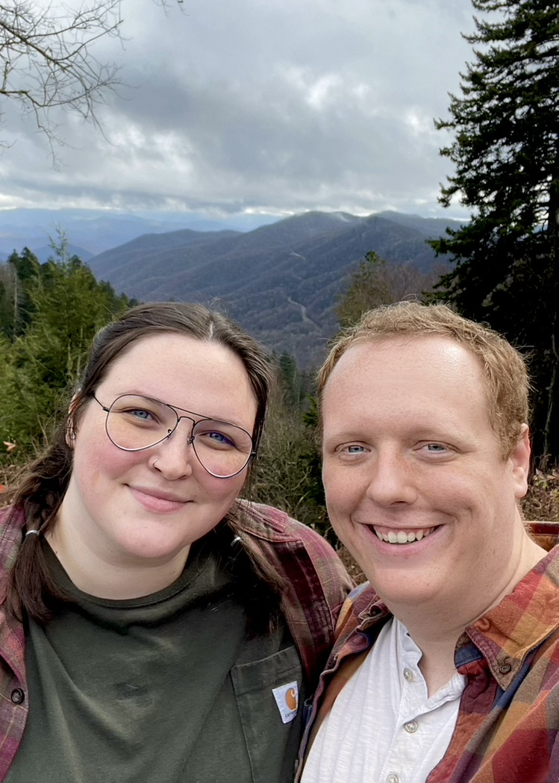
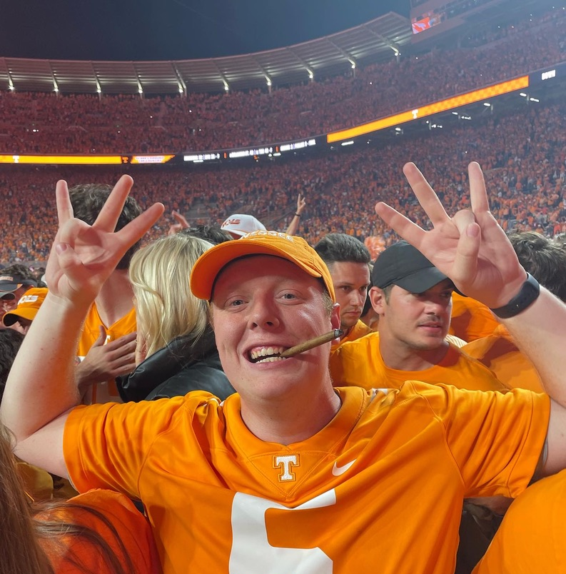
About Me
Notes:
Arthur - 1.25 Yr old
Mackenzie – Played clarinet for 7 years
Tennessee - Bama game: greatest night of my entire life and it's not close

Slide 5
Test Questions
(Open-ended) What qualities are desirable in an ideal maze? Should it have few long branching paths or many shorter branching paths?
Which maze generation algorithm creates an unbiased maze?
What is a solving approach that is highly parallelizable?
(Optional) Any feedback on the presentation would be appreciated?
Notes:
No "right" answer to #1

Slide 6
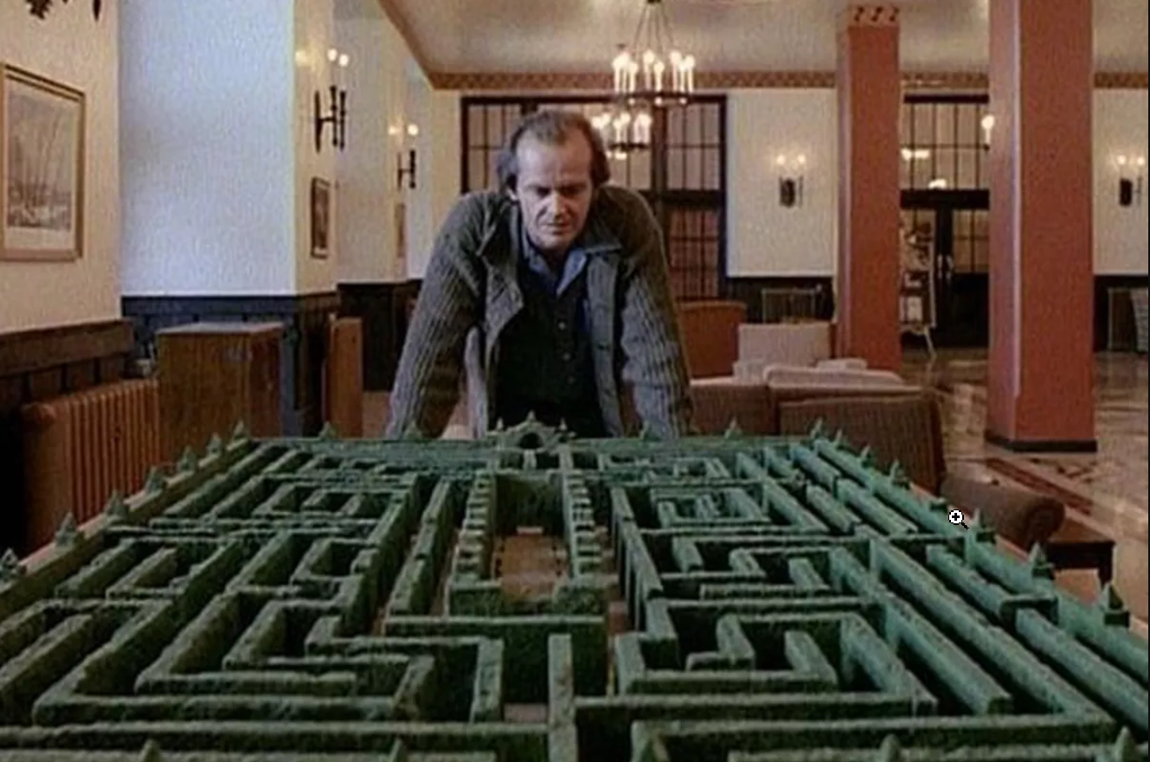
Agenda
History
Maze Generation Algorithms
Maze Solving Algorithms
Applications
Implementation
Open issues
References
Discussion
Notes:
We’re going to discuss in-depth generation algorithms
Solving discussion will be more philosophical

Slide 7
History

Slide 8
Generation: Randomized DFS
Iterative DFS routine
Recursive works too, but recursive depth gets very deep
Algorithm begins backtracking when it has created a path in the maze which reaches a dead end
Bias
Creates mazes with few long, winding paths.
Notes:
A note on the animations: they are not meant to show speed of algorithm: 1 time step: 1 wall removed from the maze (aka an edge added to the graph)
My recursive python implementation maxed out python’s recursion depth, so I switched to an iterative approach
Let’s talk about bias: not all maze generation algorithms are created equal
Longer passages, like this algorithm might be preferred for a paper maze
We might want shorter branching paths or a mix of the two for a maze that a person would navigate

Slide 9
Generation: Randomized Prim’s Algorithm
Modification to Prim’s algorithm
Edges don’t have weights
Select an edge at random
In normal prim’s, you select by weight
Prim’s works on “walls” aka edges
Bias
Biased toward creating many short passageways
High branching factor
Notes:
By selecting a random edge, you are essentially assigning a random weight to all edges
Equivalent to running normal prim’s on a random edge weighted graph
When you think about it like that, it makes sense to see how the minimum spanning tree maps to creating mazes

Slide 10
Generation: Wilson’s Algorithm
Uses loop-erased random walks
Pick a random cell not already in the maze
Perform a random walk until we find a cell that is in the maze
If we find a loop while walking, erase the loop and keep going
Bias
Takes an unbiased sample from the uniform distribution over all mazes
Remains unbiased even when the starting cell is not random
Notes:
Dr. Langston might know who Wilson is, but I couldn’t find anything about them online
Bias: remains unbiased when the starting cell isn’t random, so long as the walk remains ”random”
Provides a nice middle ground mix of long corridors and short dead ends

Slide 11

Solving: Search Algorithms
“Classic” Graph Theory search algorithms
DFS, BFS
Dijkstra’s
A*
Drawback of each
The cornfield problem
They require a top-down, omniscient view of the maze
Notes:
What are you to do if you get dropped at the entrance to a cornfield maze?
Simple answer is follow the wall to your right or left

Slide 12
Solving: Trémaux's algorithm
Works by drawing lines on the floor
At the entrance to each passage, mark unvisited, visited once, or visited twice
Leave mark at each entrance
Choose which passage to go thru at junction based on the markings
Notes:
The rules are:
If only the entrance you just came from is marked, pick an arbitrary unmarked entrance, if any. This rule also applies if you're just starting in the middle of the maze and there are no marked entrances at all.
Pick the entrance you just came from, unless it is marked twice. This rule will apply whenever you reach a dead end.
Pick any entrance with the fewest marks (zero if possible, else one).

Slide 13
SOLVING: Cellular Automata
Treat each square in the grid as a “cell” in a CA system
One simple rule for each cell
If a cell is closed in on 3 sides, add the fourth wall on the next iteration
Blocks off all dead ends
Benefits
Massively parallelizable
Drawbacks
Must traverse all cells not part of the solution

Slide 14
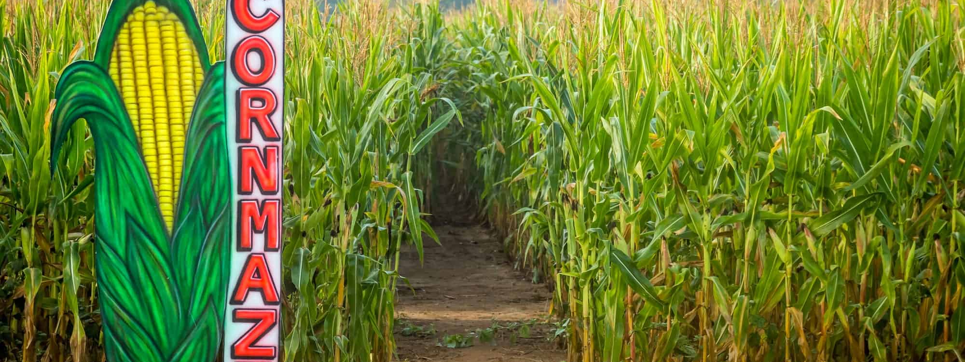
Applications
Dropped in a corn maze

Slide 15

Implementation details
Language: python
Testing machine:
2020 Macbook Pro
1.4 GHz Intel i5
8GB Memory
Notes:
The last intel mac ever made

Slide 16
Results

Slide 17
References
https://en.wikipedia.org/wiki/Maze_generation_algorithm
https://en.wikipedia.org/wiki/Maze-solving_algorithm
https://www.smithsonianmag.com/travel/winding-history-maze-180951998/

Slide 18
Test Questions
(Open-ended) What qualities are desirable in an ideal maze? Should it have few long branching paths or many shorter branching paths?
Which maze generation algorithm creates an unbiased maze?
What is a solving approach that is highly parallelizable?
(Optional) Any feedback on the presentation would be appreciated?
Notes:
No "right" answer to #1

